Slide 1


Advancing Patients’ Care
PacePress | CoolCryo | MiniMax | AtriClamp
Corporate presentation
June 2025
© 2025 Medinice S.A. All rights reserved.
© 2025 Medinice s.a. All rights reserved.

Slide 2
FORWARD LOOKING STATEMENT
We develop advanced solutions
to support patients with cardiovascular diseases
LEGAL NOTICE
This document has been prepared for information purposes only. It does not constitute an advertisement or offer of securities in public trading. It uses sources of information that Medinice S.A. considers as reliable and accurate, but there is no guarantee that they are comprehensive and fully reflect the facts.
The study may contain forward-looking statements that represent investment risk or a source of uncertainty and may differ materially from actual results.
Medinice S.A. is not responsible for the effects of decisions that were taken on the basis of this study. Responsibility rests solely with the users of the study. The study is protected by the Act on Copyright and Related Rights. Reproduction, publication or distribution requires the written consent of Medinice S.A..
© 2025 Medinice S.A. All rights reserved.

Slide 3
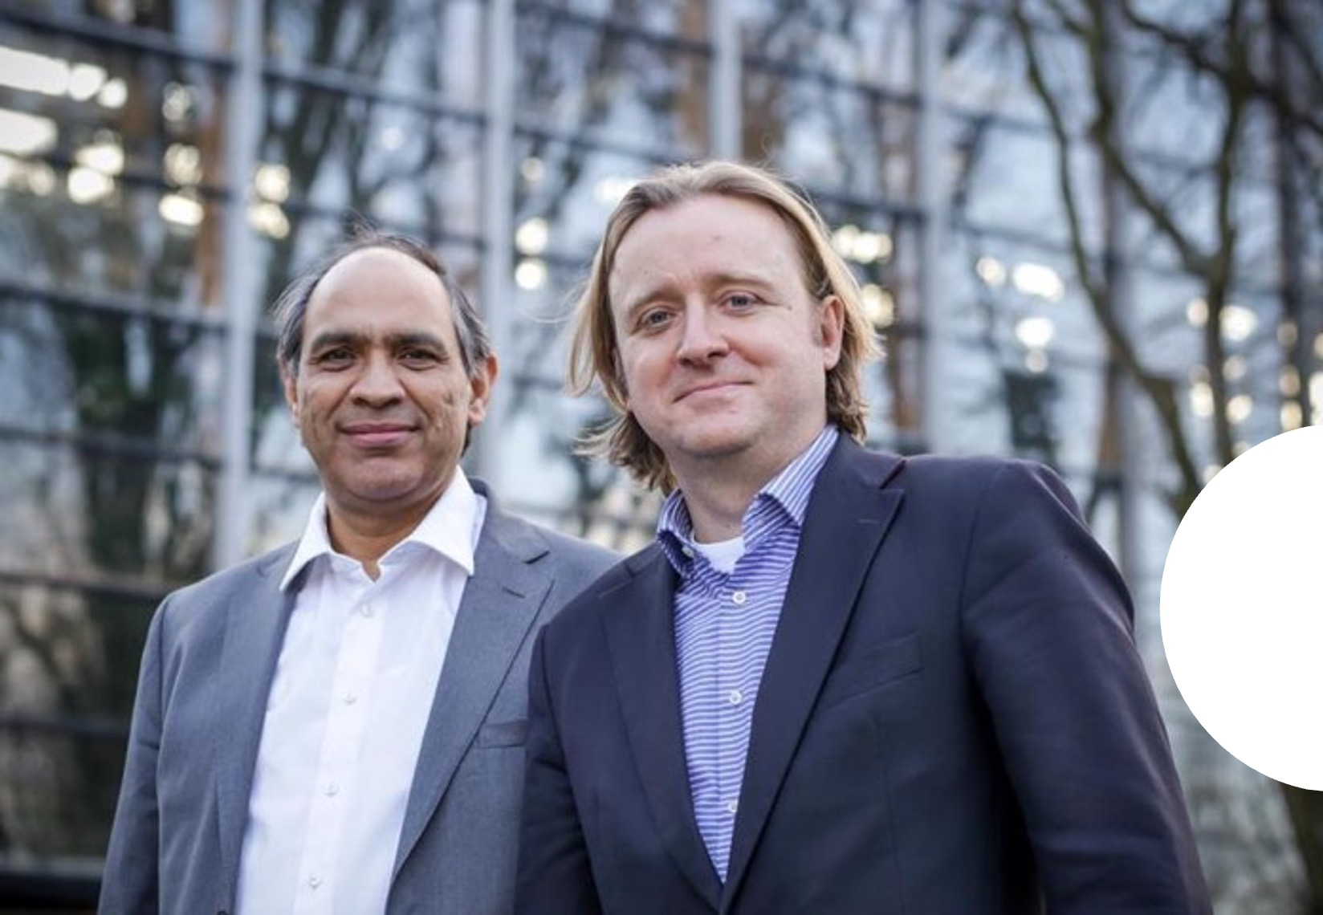
COMPANY OVERWIEV
WHO WE ARE
Established in 2012 by renowned medical professionals
and seasoned entrepreneur.
Innovates, develops, and commercializes
advanced cardiovascular care technologies.
Listed on the Warsaw Stock Exchange since 2018.
Holds ISO 13485 and CE MDR for PacePress.
Confirmed the 510(k) pathway with the FDA durging
Pre-Submission meetings for CoolCryo and for AtriClamp.
Sanjeev Choudhary Piotr Suwalski MD PhD Proffesor of medinice
Co-Funder Co-Funder / Co-Inventor
Chief Executive Officer Chairman of the Scientific Board
Notes:
Established in 2012 by esteemed medical experts and a seasoned entrepreneur.
The company focuses on the innovation, development, and commercialization of cutting-edge cardiovascular care technologies.
Holds ISO 13485 certification and CE MDR approval for PacePress.
Confirmed the 510(k) pathway with the FDA during Pre-Submission meetings:
For CoolCryo, expected in Q4 2023 / Q4 2024 / Q1 2025 / Q1 2024,
For AtriClamp, anticipated in Q2 2024.
Has been listed on the Warsaw Stock Exchange since 2018.

Slide 4

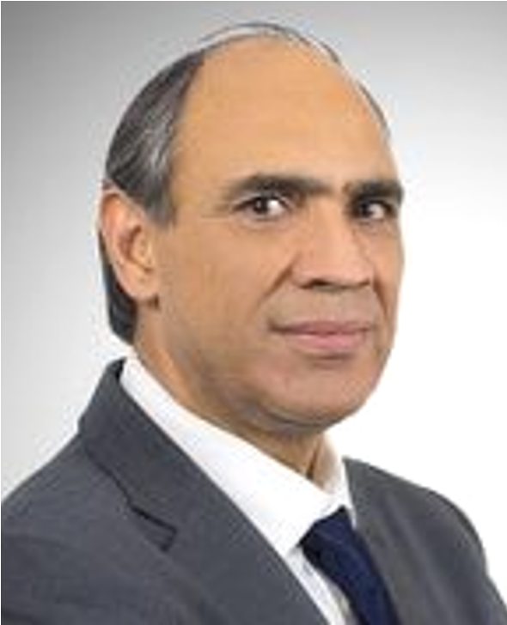
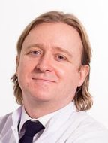
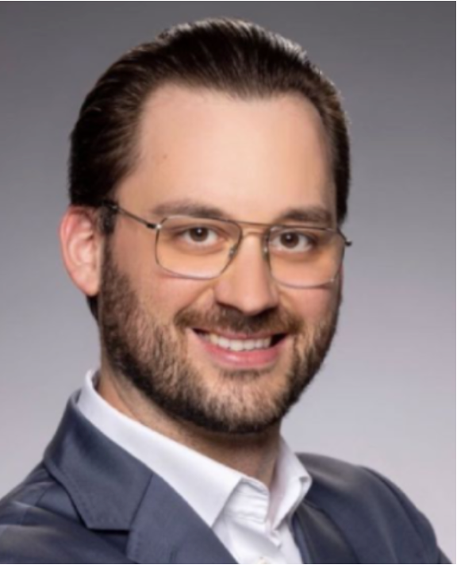
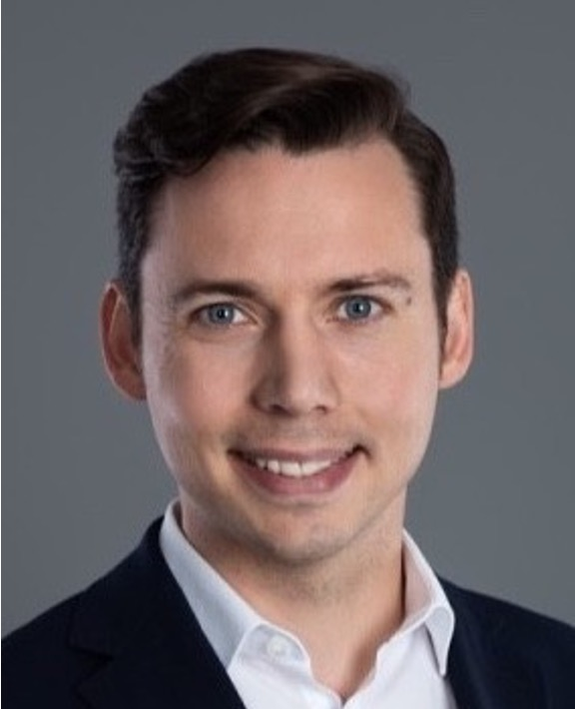
LEADERSHIP TEAM
Sanjeev Choudhary
CEO & CO-FOUNDER
Graduate of Wroclaw University of Technology, Ashridge Business School, MBA, INSEAD and Centre for Creative Leadership programmes
Piotr Suwalski
MD PhD Prof
CO-FOUNDER CO-INVENTOR
First LAAO in 2009 in Poland. The only surgeon in Europe with 500+ robotic surgeries. Member of 21st Century Club
Ex-President of the ISMICS.
Piotr Lozinski
CFO
15+ years of experience Finance
in FMCG and medical devices sectors. M&A advisory. Successful equity and debt rounds. Fellow member of ACCA and Institute of Internal Auditors
Greg Wróblewski
Med. Eng. PhD
CTO
Inventor of technology integrated by Medtronic. Developed 4 medical devices (2nd and 3rd class), 15+ years of experience in R&D, >50 scientific papers

Slide 5
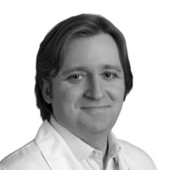
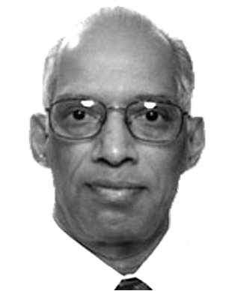

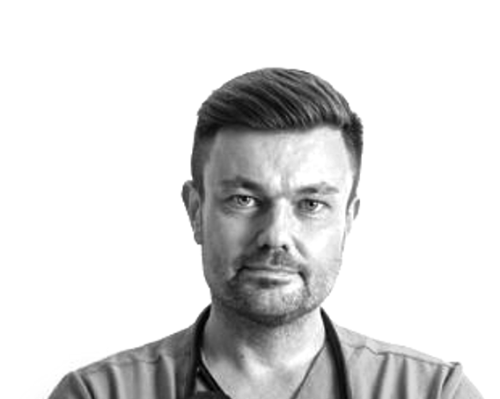
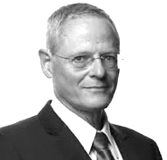
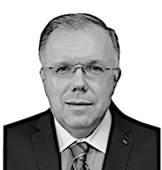
SCIENTIFIC BOARD
CARDIAC SURGERY
ELECTRO PHISIOLOGY
Piotr
Suwalski
MD, PhD, Prof
Director of National Medical Institute of MIA in Poland. Former president of ISMICS, member of ESC i EACTS, 21CCSS
Valavanur
Subramanian MD, PhD
Head of Lenox Hill Cardiac Surgery - Manhattan. Pioneer of minimally invasive
cardiac surgery.
Founder of ISMICS.
Paul
Gründeman
MD, PhD
Former Director
of the Experimental Cardiothoracic and Vascular Surgery
at Utrecht Medical Center. Co-inventor of the Octopus device
Paweł
Balsam
MD, PhD, Prof
Head of Clinical Electrophysiology Department at WUM, professor of medical sciences, specialist
in arrhythmia ablation and cardiovascular disease prevention
Michael
Glikson
MD, PhD, Prof
Director of Jesselson Integrated Heart Center, professor at Hebrew University and Mayo College, former president of Israel Heart Society
Adam
Budzikowski
MD, PhD
Downstate Director at SUNY Downstate, New York. Over 30 years of experience in clinical medicine.
Member of the PSC and ESC and HRS

Slide 6
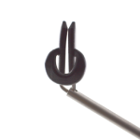
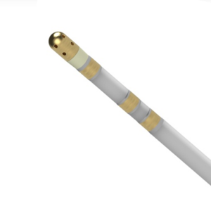
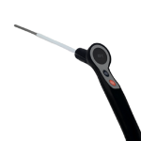
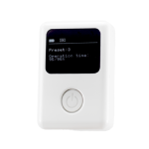
PROJECT PORTFOLIO
Pipeline of wide range innovative medical devices
AtriClamp
MiniMax®
CoolCryo®
PacePress®
epicardial
LAAO device
RF ablation catheter offering 3D mapping and cooling
quick & powerful
epi- & endocardial
cryoablation
prevention of
hematoma after
CIED implants
PROTOTYPING
R&D
PRECLINICAL
TESTING
CLINICAL TRIALS
CERTIFICATION
Market entry
MARKET
Licencing / Selling
/ Partnership

Slide 7
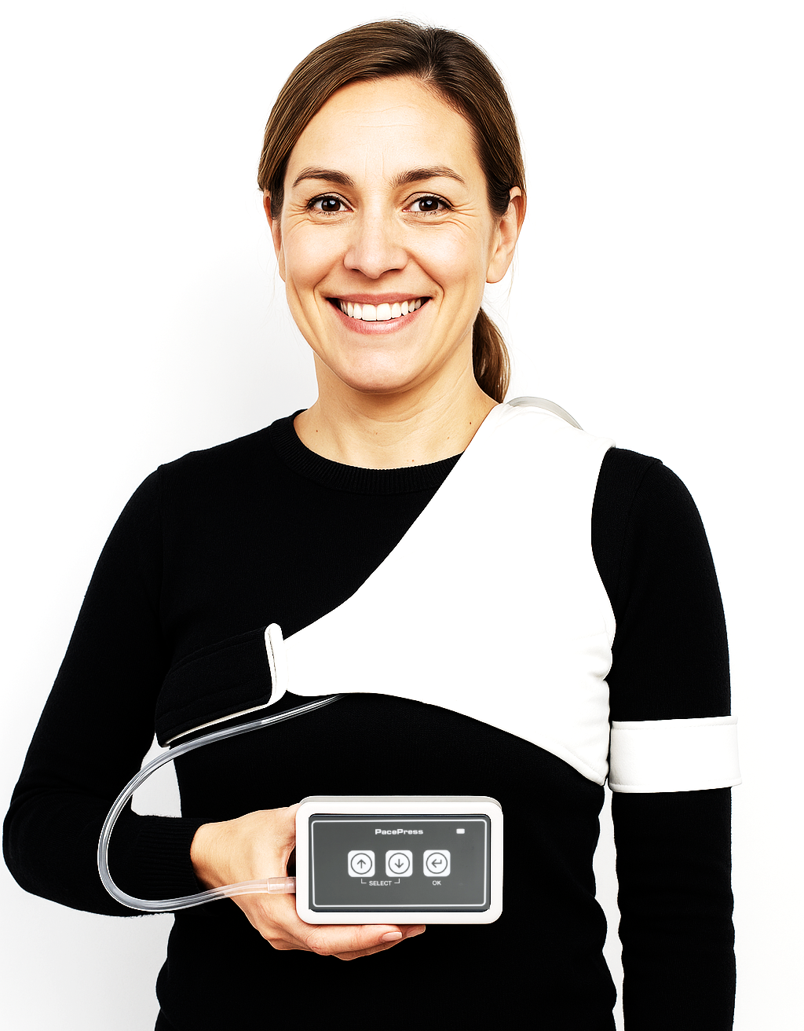
ADVANCED WOUND CARE
PacePress®

Slide 8
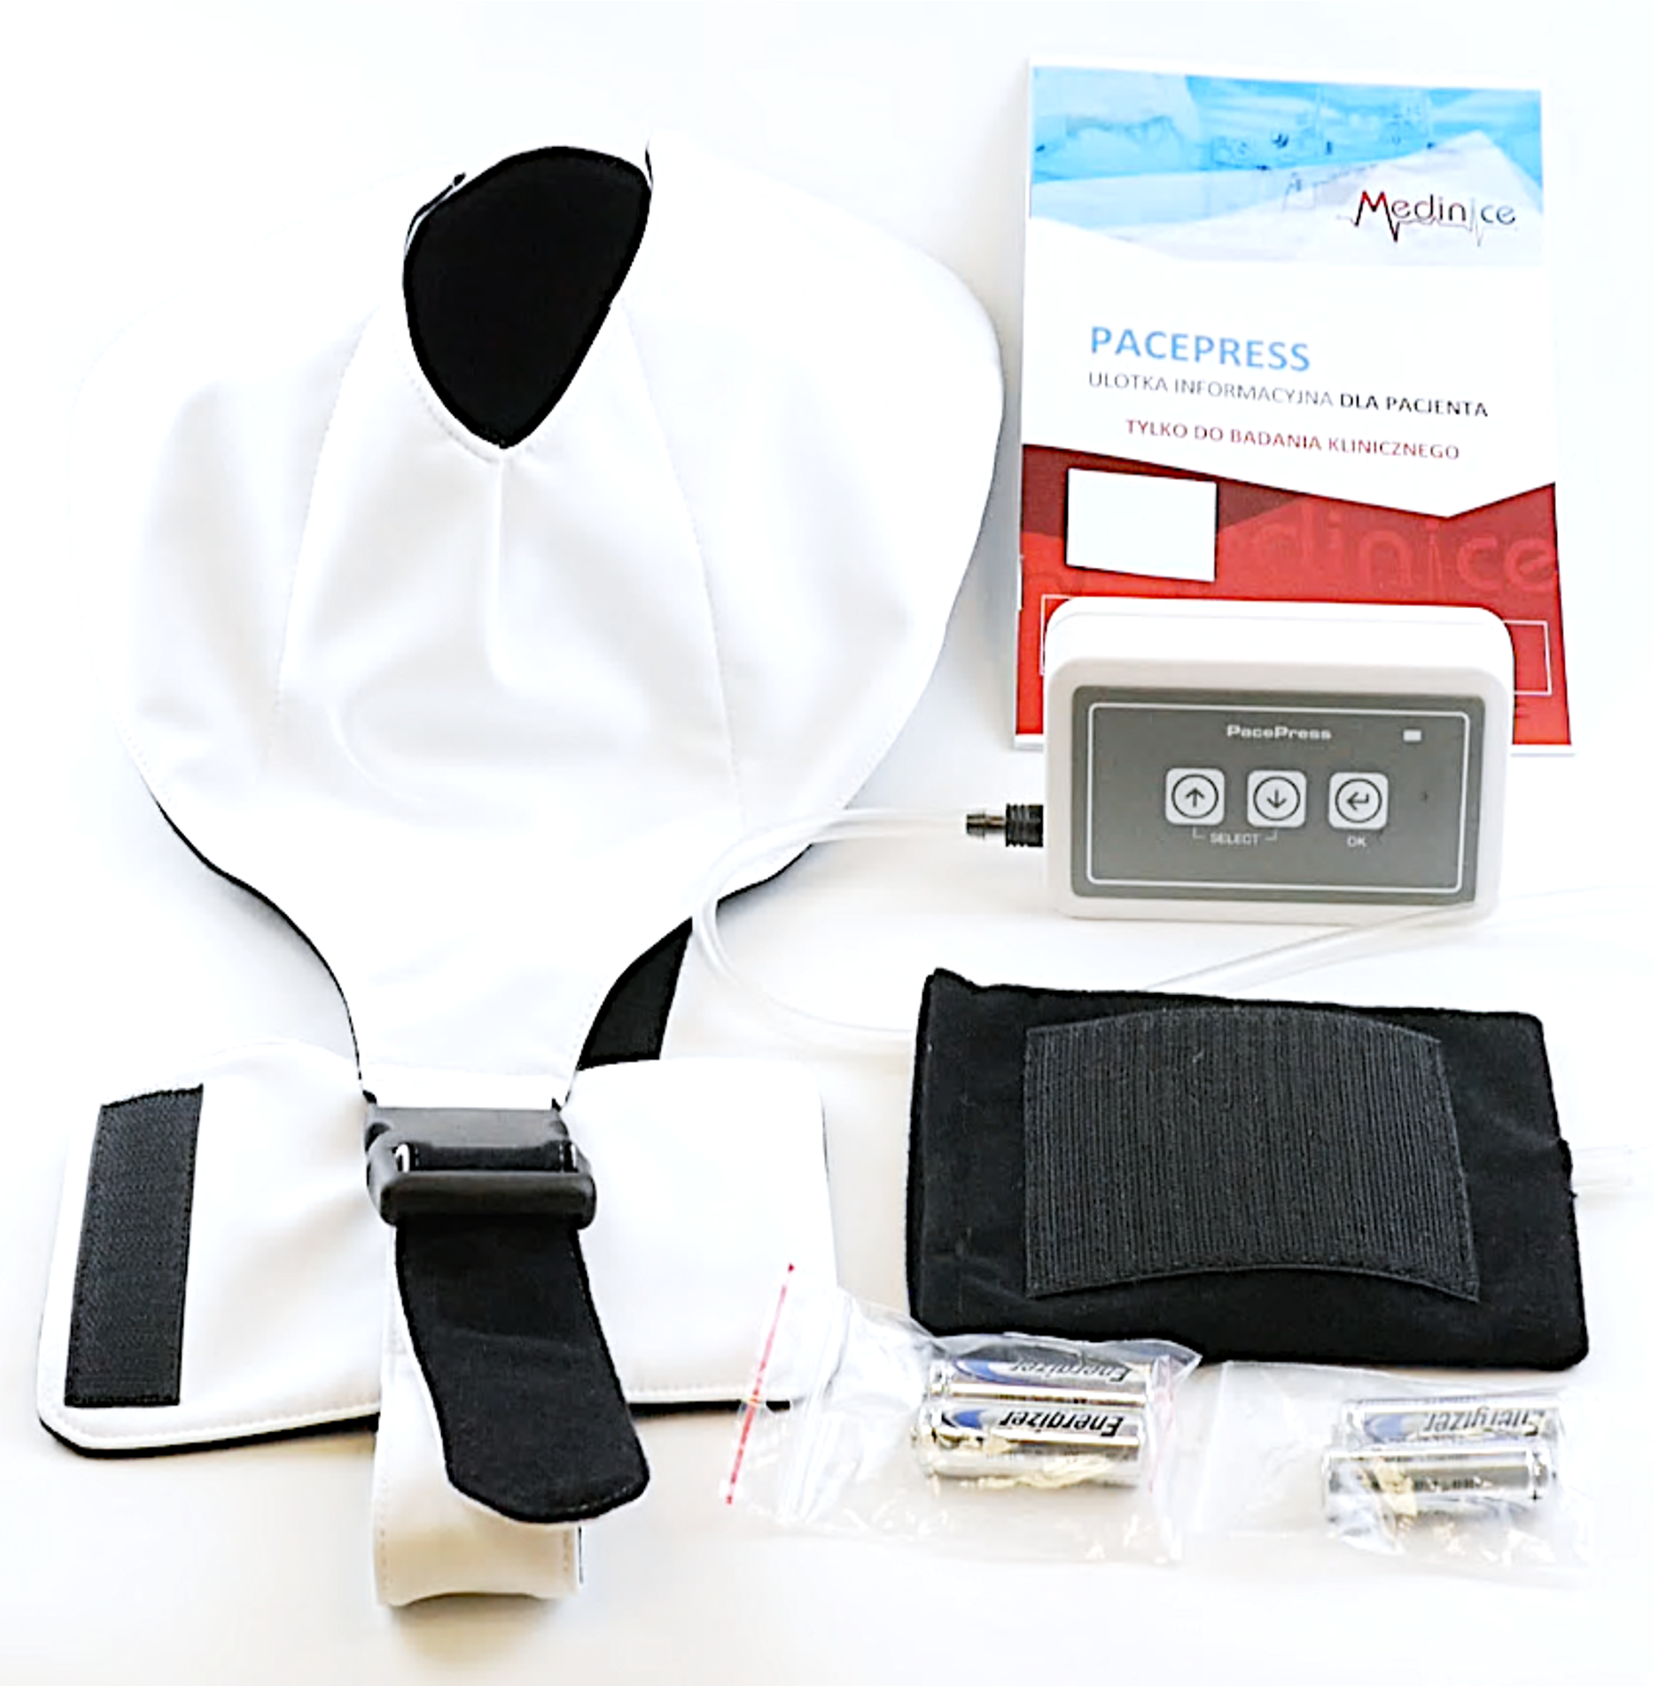

PACEPRESS®
Safer and faster recovery after implantations
of Cardiac Implantable Electronic Devices
PacePress is pneumatic therapeutic medical device
designed to minimize the risk of complications
after CIED implantations, while ensuring patient comfort, mobility and recovery.
Key features
Reduces the risk of complications:
infection and hematomas
Shortens hospitalization
Increases patient control and safety

Slide 9
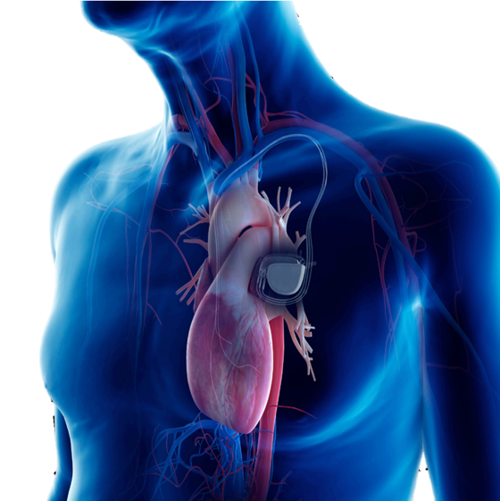
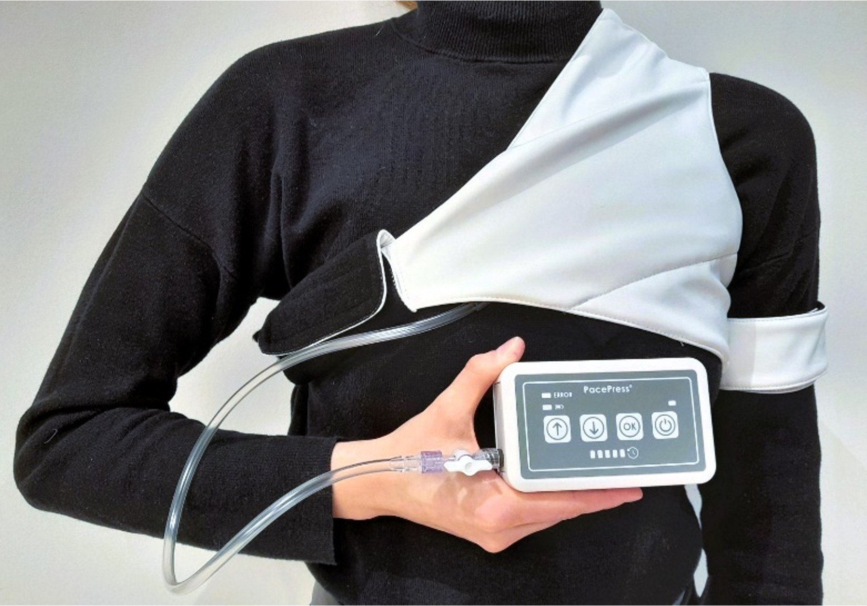
CIED POSTOPERATIVE COMPLICATIONS
1.5 million procedures
performed annually worldwide
About 60% of patients undergoing CIED implantation procedures are at risk of postoperative complications.
Approximately 10% of CIED procedures result in chest cavity haematomas, potentially leading to infection and re-operation.
Current prevention methods include:
patient immobilization
applying pressure to the implantation site
CIED
implantation site

Slide 10
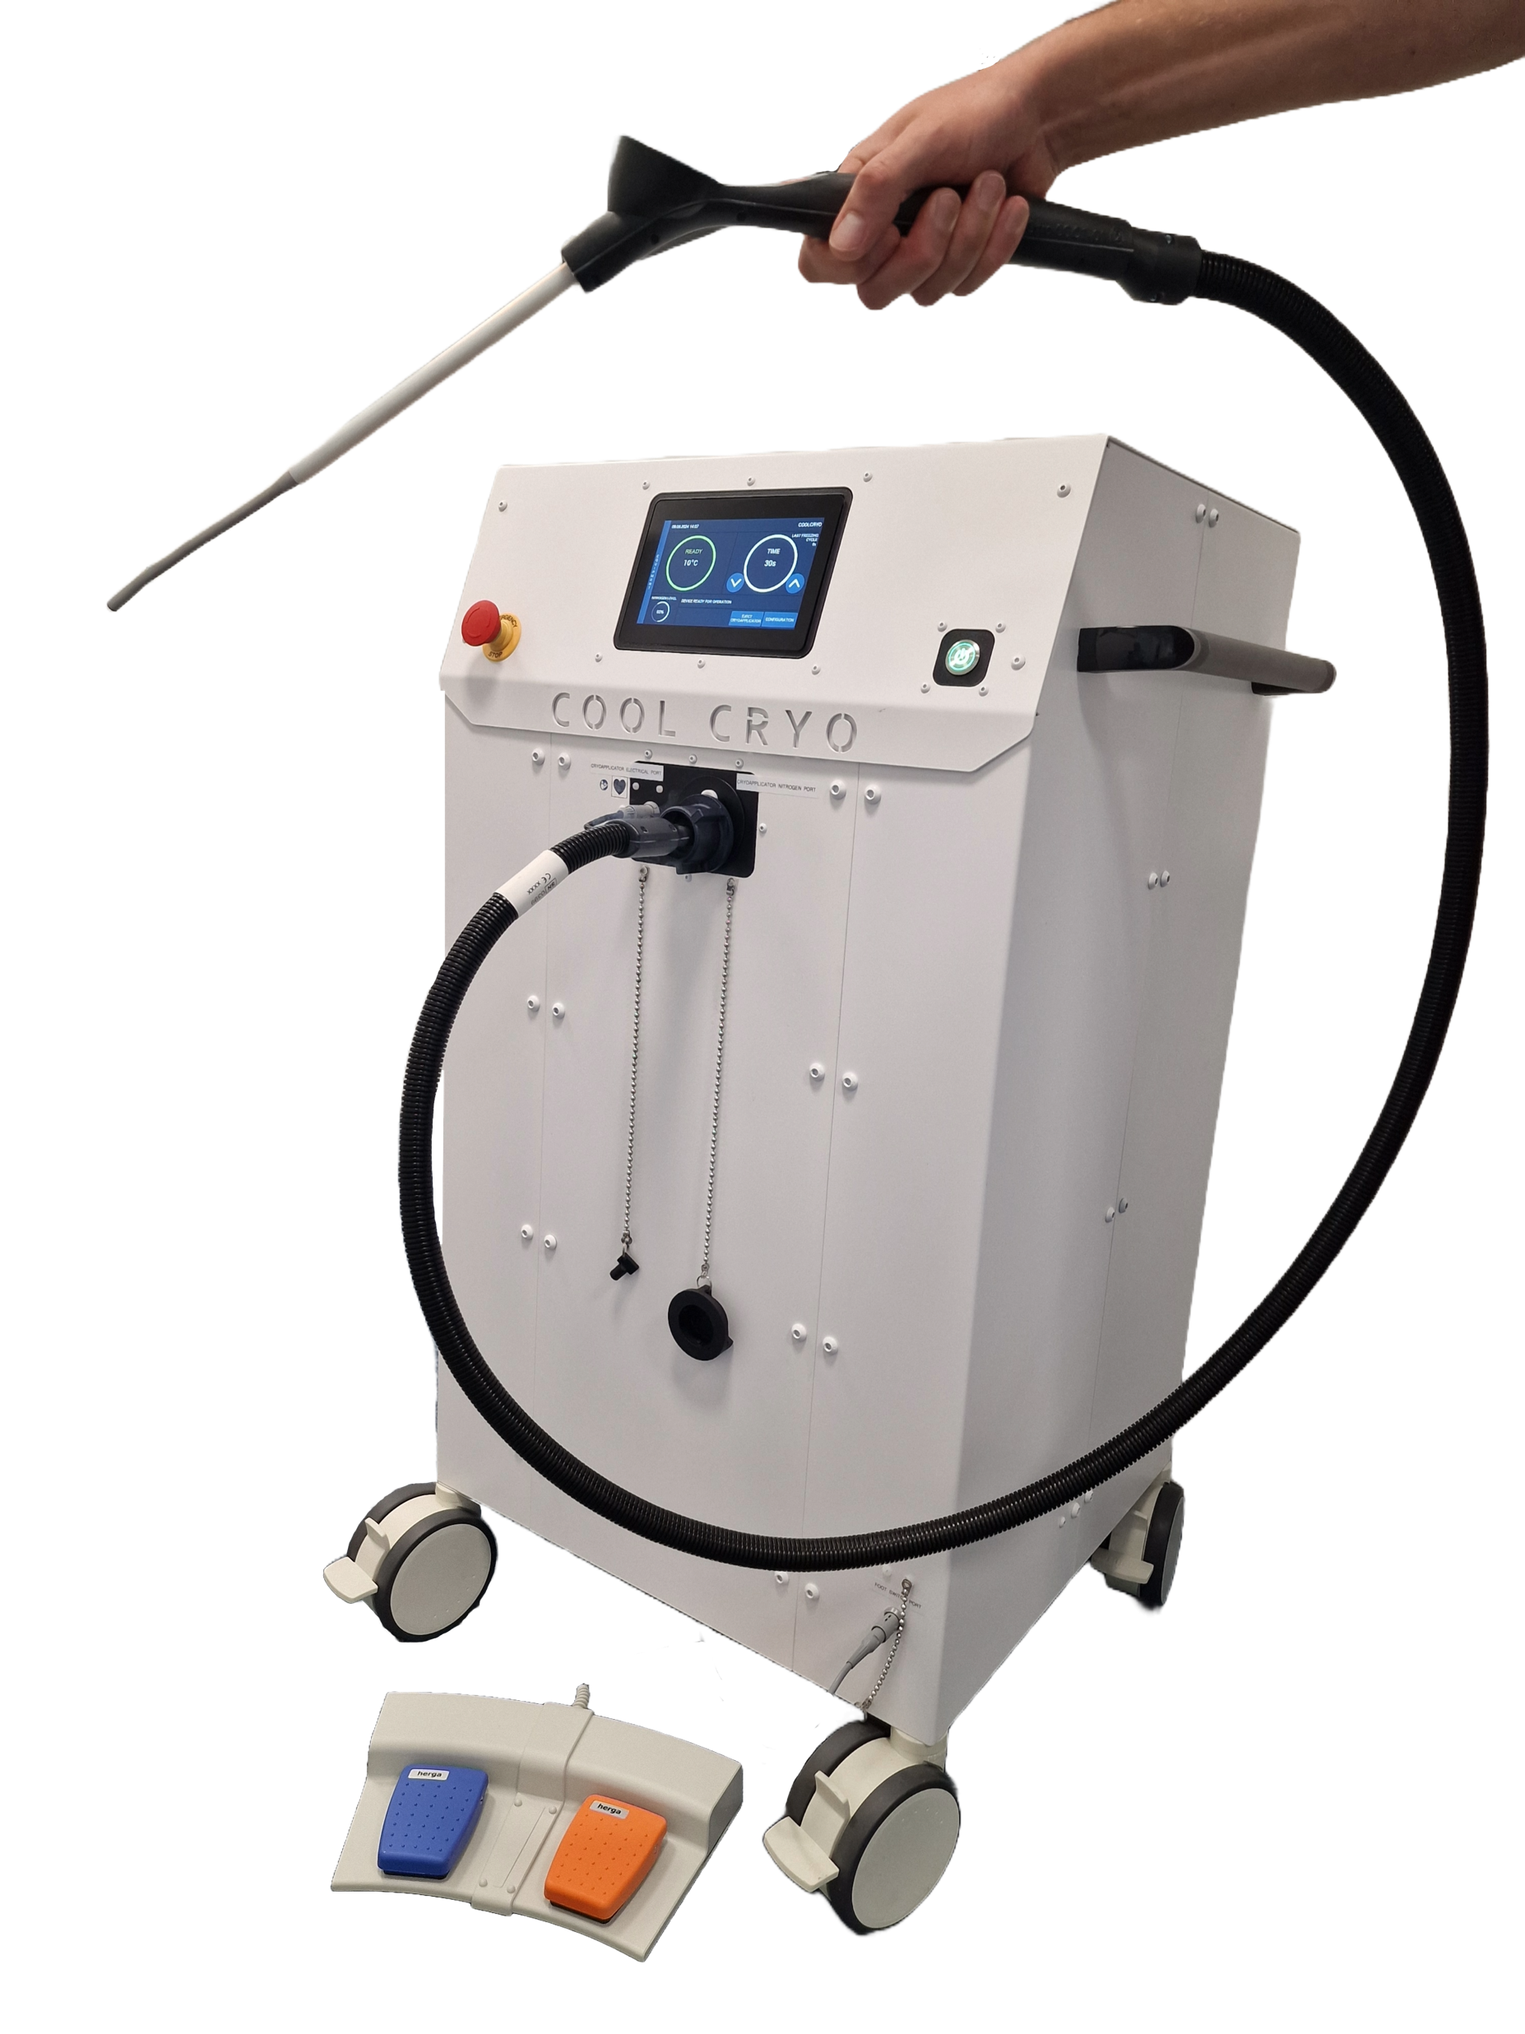
CRYOABLATION
CoolCryo®

Slide 11
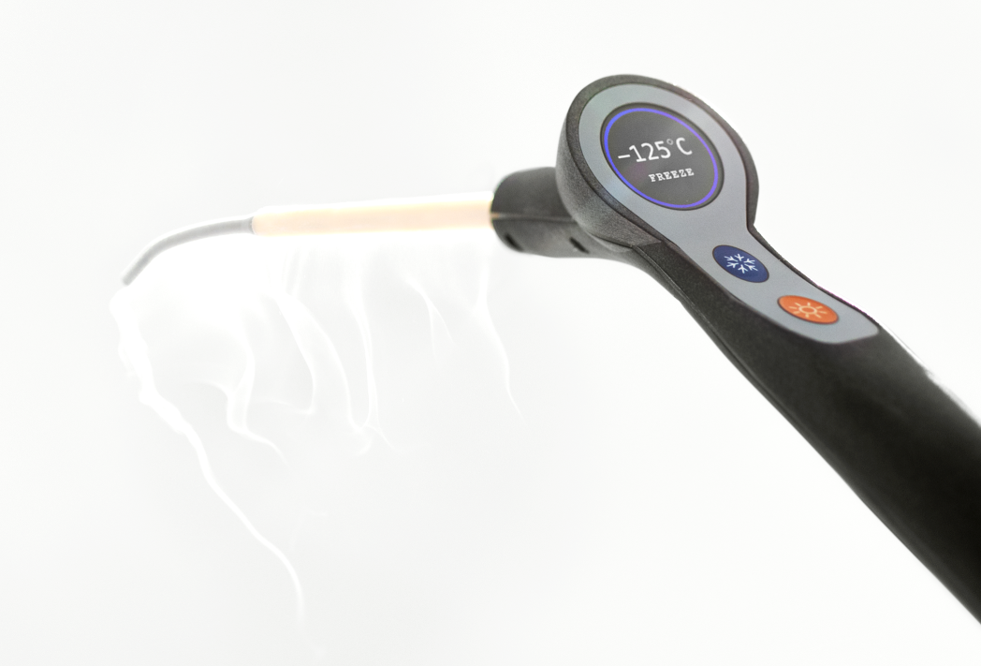
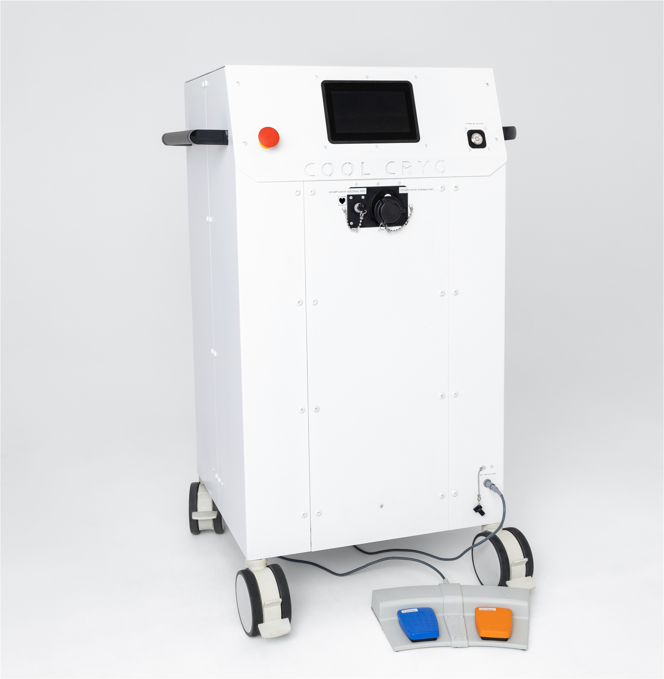
COOLCRYO®
Faster and more efficient cardiac cryoablation system
The CoolCryo® system is designed for the cryosurgical treatment of arrhythmic cardiac tissue ablation
by freezing target tissues, inducing an inflammatory response (cryonecrosis) that blocks the electrical conduction pathway. Using liquid nitrogen makes cryoablation faster and more cost-effective.
Key features
at least four times faster and more efficient cryoablation
possibility of minimally invasive endoscopic surgery
possibility of continuous cryoablation and defrosting
possibility of full-wall ablation of even thick tissues
cheaper and more efficient cooling medium
Ongoing clinical trials & FDA 510K submission

Slide 12
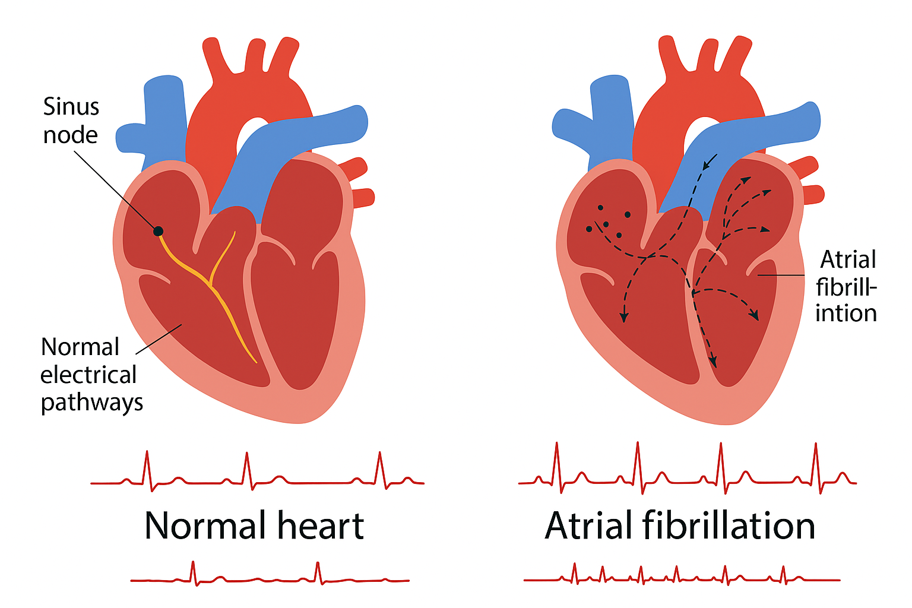
CARDIOVASCULAR DISEASES
59 mln people worldwide
suffer from arrhythmia
Arrhythmia ranks among the most prevalent
heart conditions. It can result in
circulatory failure and strokes.
The preferred treatment approach is ablation.
Currently, ablation treatments include:
Cryoablation (CoolCryo®) – freezing method
Radiofrequency (MiniMax®) or Pulsed Field – burning method

Slide 13
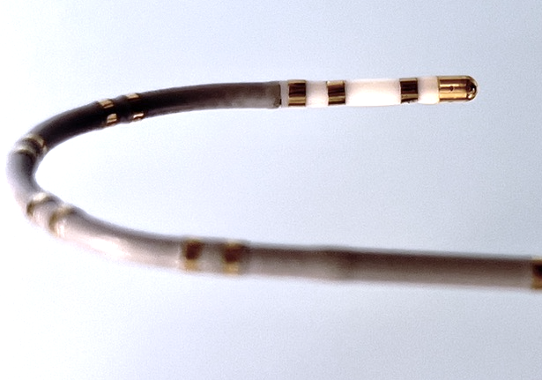
RF ABLATION
MiniMax®

Slide 14

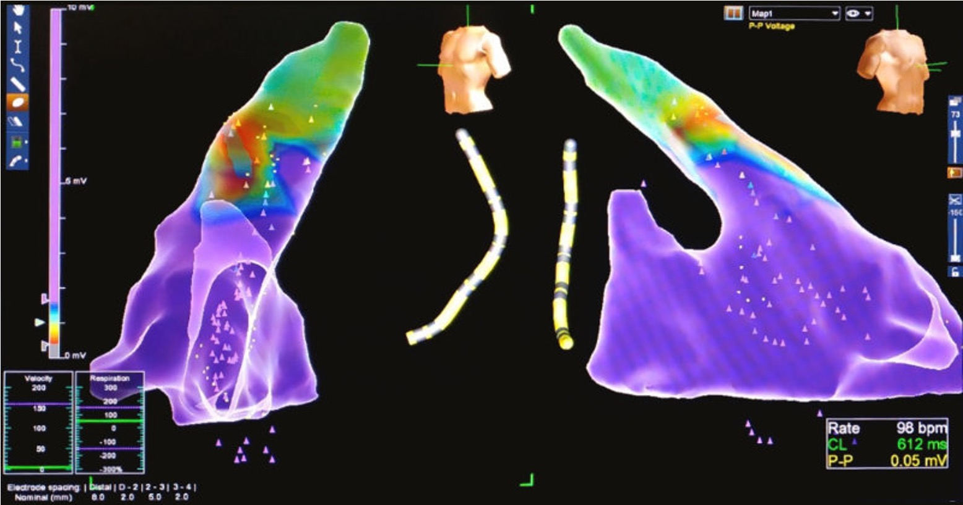
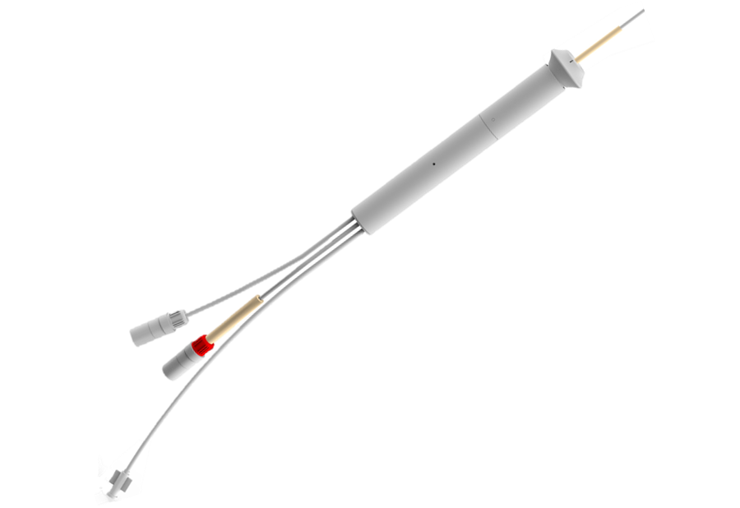
MINIMAX®
Versatile RF ablation catheter
offering 3D mapping and cooling
MiniMax® is a steerable, minimally invasive 2-in-1 catheter developed for the treatment of cardiac arrhythmias during RF ablation procedure.
It combines ablation and 3D mapping functions
to reduce both the risk and duration of the procedure. Additionally, it features cooling system using NaCl.
Key features:
2 in 1 – Ablation + 3D electro-anatomical mapping
Safer procedure – shorter time and lower risk
Advanced NaCl cooling
Flexible and steerable tip
X-ray free – modern visualization

Slide 15
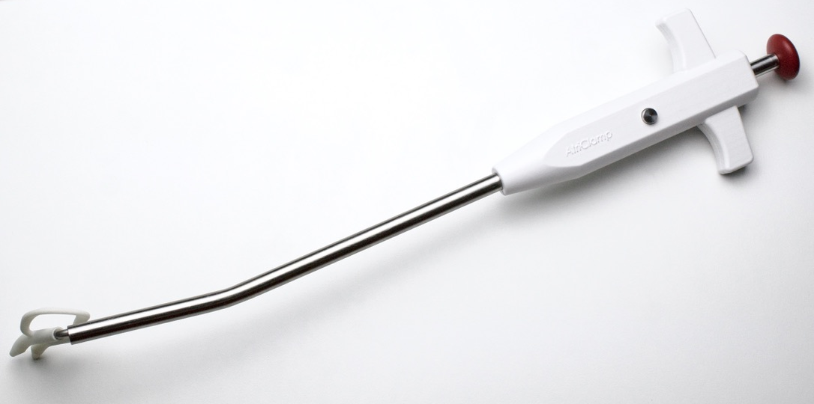
LEFT ATRIAL APPENDAGE MANAGEMENT
AtriClamp

Slide 16
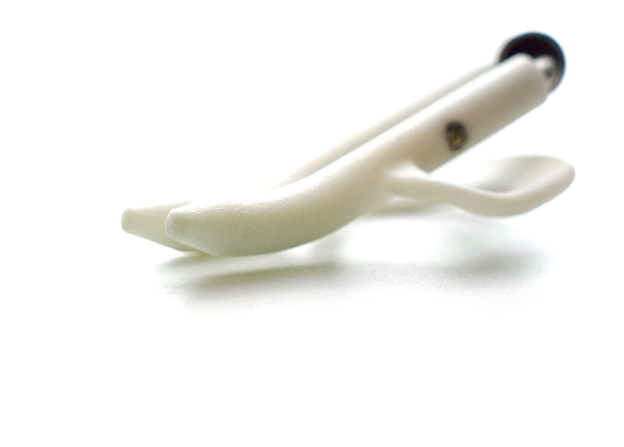
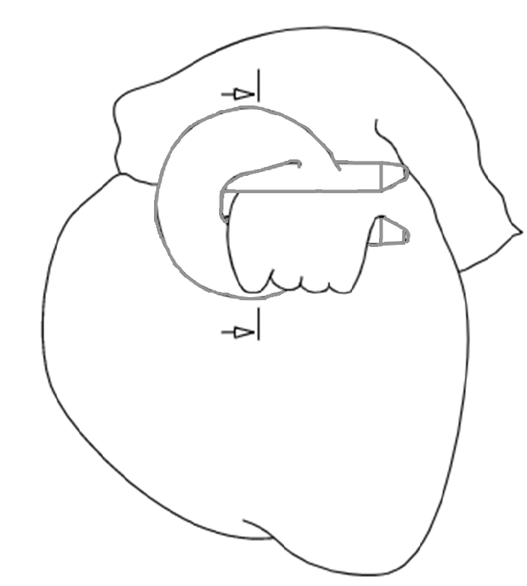
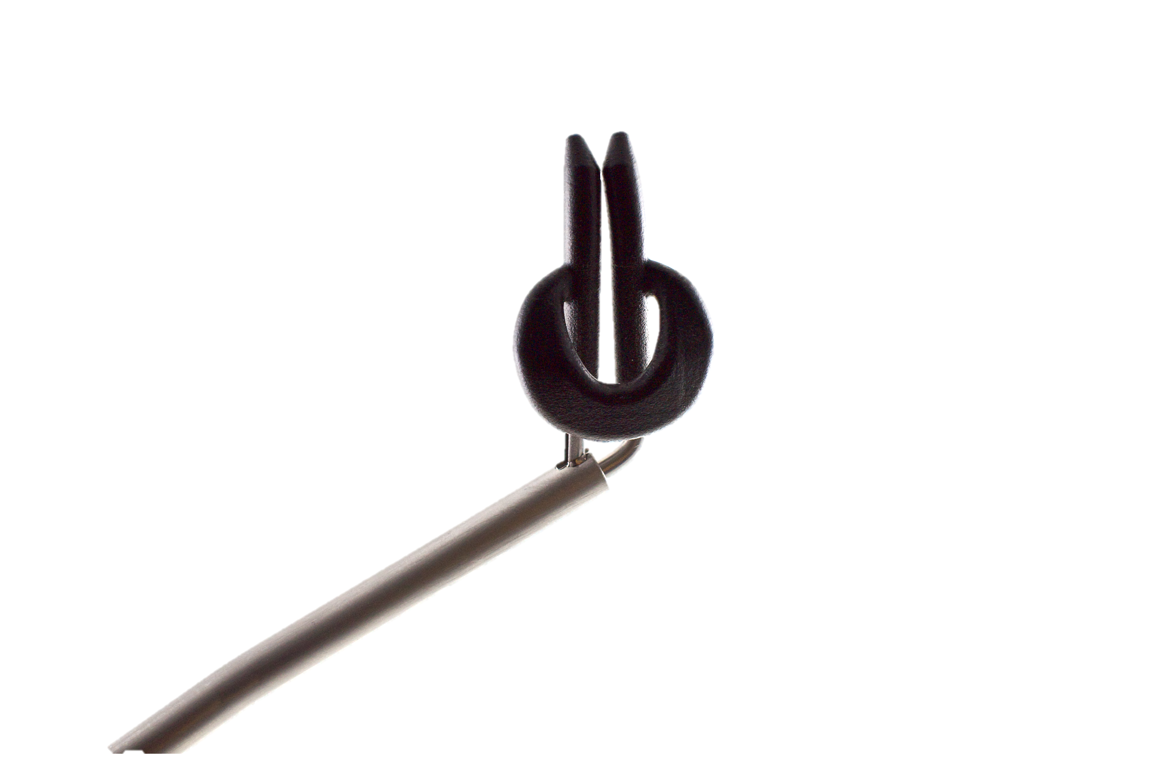

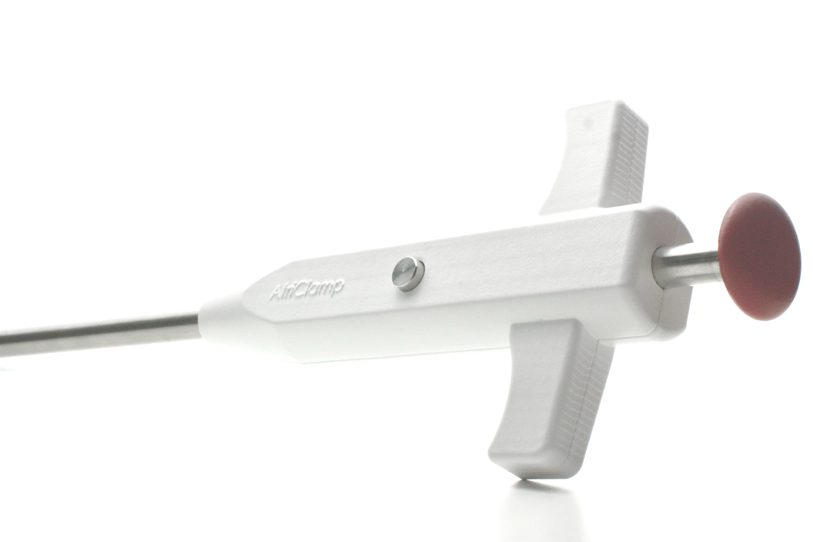
ATRICLAMP
Scalable Left Atrial Appendage Closure system
AtriClamp is a cardiothoracic clamp designed for the LAAC procedure. Utilizing an epicardial approach, it eliminates the need for threading through the appendage, keeping blood clots sealed within the appendage.
Key features:
low-cost and scalable production method
fully retrievable & repositionable
designed for single-handed operation
no Dacron® used
© 2025 Medinice S.A. All rights reserved.

Slide 17
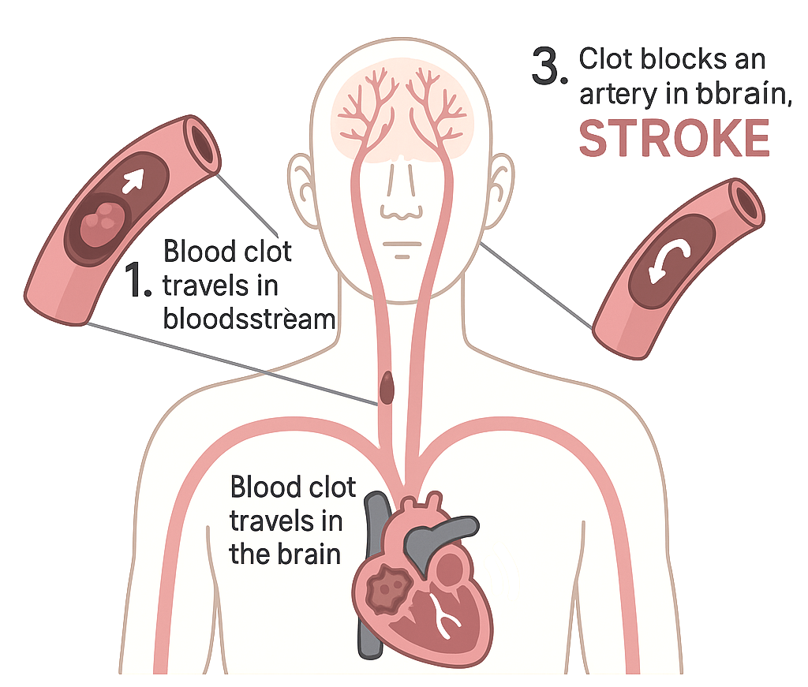
STROKE PREVENTION
15 million people affected annually
According to the World Health Organization, stroke is a leading cause of death,
accounting for 11% of all deaths worldwide^{[1,2]}.
The left atrial appendage closure procedure prevents 90% of embolic material, leading
to 87% of strokes. This procedure will now
be performed routinely with other cardiac surgeries, and we have therefore prioritized
economic aspect of AtriClamp.
[3] Dudzińska-Szczerba, K., Association between left atrial appendage morphology and function and the risk of ischaemic stroke in patients
with atrial fibrillation, Arrhythmia & Electrophysiology Review 11 (2022).
[1] World Health Organization - Fact sheets
[2] World Health Organization – Definitions: Stroke

Slide 18
SUMMARY
Repeatable revenue model
Growing demand
An experienced team
Growing demand for minimally invasive technologies
Ageing population
Scientific Council composed of world-renowned scientists and inventors
Experienced management and project teams
Competitive advantages
Large and healthy target market
Diversified portfolio
Patent protection future projects for development
Potential buyers are global corporations
The technologies under development fit in the portfolio of potential counterparties
Two projects near commercialisation
Notes:
• Wspołpraca z FDA
• Ta sama grupa key Opinion Leaderów

Slide 19

Thank you for your attention
www.medinice.eu

Slide 20
APPENDIX
Medinice
®
APPENDIX
In response to the needs of doctors,
we break the boundaries of technological innovation.
To ensure the quality of life of patients,
we create minimally invasive and safe medical devices.

Slide 21

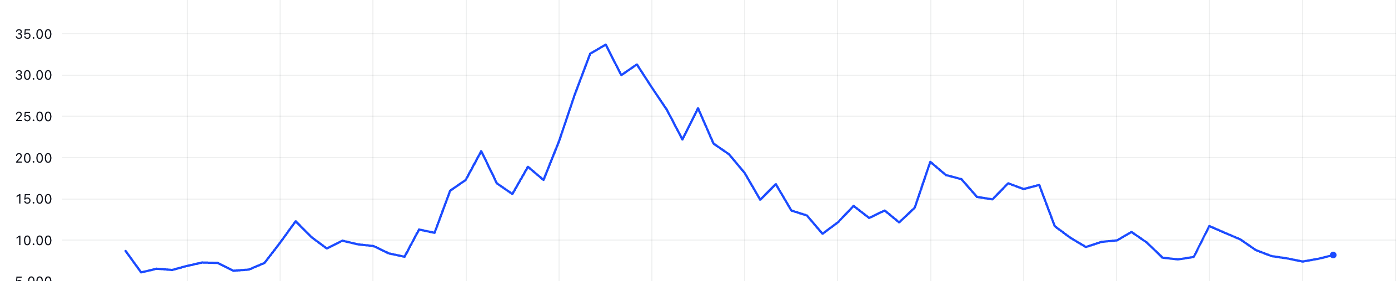
ABOUT
17 M PLN
grants received
54 M PLN
funds raised
589 M PLN
est. projects value
25% founders
75% free float
New projects acquisition
CoolCryo
preclinical trials
PacePress
clinical trials
MiniMax
preclinical trials
CoolCryo positive
animal trials report
CoolCryo
human trials
PacePress
CE MDR
AtriClamp
UE grant

Slide 22
MED-TECH MARKET
GROWING MARKET EXPANDING NEEDS
Thanks to the development of medical devices,
it has been possible to reduce mortality by 67% and increase life expectancy by 62%
(+30 years). The consequence of this is an increasing number of diseases.
Global 60+ population in millions.
Global share of 60+ in the population.
According to the WHO, 29% of deaths worldwide (16 million people), are due to heart disease and stroke.
It is also the fastest growing threat for our civilisation (increasing by 100,000 people a year).
Cardio device market size in billions of USD.
CAGR = 7,9%
8% 10% 13% 16%

Slide 23




CARDIAC MARKET
Advancing through the development process enhances the product’s value
LAAO market
250 K procedures annually
$1.9 B market size
300 mln USD
acquisition of SentreHEART
by AtriCure in 2019
AtriClamp
RF Ablation market
1.5 M procedures annually
$5.5 B market size
125 mln USD
w 2023 MACOM acquisition
of Wolfspeed RF portfolio
MiniMax®
Cryoablation market
approx. 400 K annual indications
$800 M market size
150 mln USD
JapanLifeline acquired
CardioFocus in 2020
CoolCryo®
CIED market
1.2 M procedures annually
$1.5 B PacePress market size
125 mln USD
ConvaTec acquired
Triad Life Sciences in 2022
PacePress®

Slide 24


BASED OD PREDICATES, TO BE CONFIRMED IN CLINICAL TRIALS
 |  | 2014 | 2016 | 2017 | 2019 | 2020 | 2021/22 | 2023/24
RECOMMNEDED use during procedure
REASONABLE use during procedure
CONSIDERED use during procedure
CoolCryo
MiniMax
AtriClamp
PacePress

Slide 25





















OUR ECOSYSTEM
UNIVERITIES ORGANIZATIONS HOSPITALS

Slide 26
ADVANCED WOUND CARE
PacePress®
© 2025 Medinice s.a. All rights reserved.

Slide 27





PACEPRESS
Significant advantages over competitive solutions
Device type | Active Positive Pressure | Negative pressure | Pressure & Cooling
Automatic control
Automatic adjustment pressure
Data collection
After all types of CIED implantations
© 2025 Medinice s.a. All rights reserved.

Slide 28


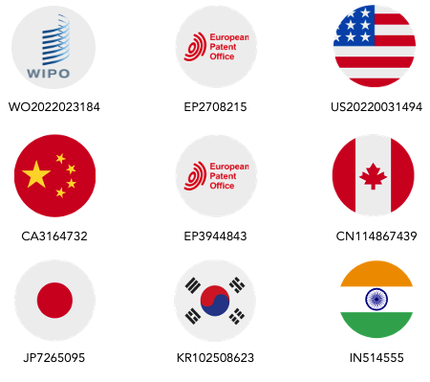
PACEPRESS
PacePress project progress
4Q
2023
2Q
2025
Amendment to the test protocol
Extension to all types of CIED equipment
interim analysis
2Q
2024
4Q
2024
1Q
2025
Initiation of
CE certification
on a comparator basis
MDR audit
+ ISO 13485
CE Certification
granted
Notes:
Badanie kliniczne: 65 pacjentów.
Wprowadziliśmy nowy mankiet, który charakteryzuje się wyższą wygoda dla pacjenta.
Rozważamy też inną ścieżkę, aby pójść na bazie komparatora tak by móc zarejestrować urządzenie bez oczekiwania na koniec badań klinicznych.

Slide 29
PACEPRESS
WOUNDCARE MARKET VALUE
342 mln USD
Hillroom purchases Bardy Diagnostics
(device for remote arrhythmia diagnosis)
BLN USD
1 200 mln USD
Boston Scientific purchased Preventice Solutions (remote monitoring services for patients with heart rhythm disorders)
2020 2022 2024 2026 2028
NUMBER OF CIED IMPLANTATIONS
1 300 mln USD
Coloplast acquired Kerecis,
a company dealing with and
producing all types of dressings
MLN
2020 2022 2024 2026 2028
https://www.gminsights.com/industry-analysis/left-atrial-appendage-closure-devices-market
© 2025 Medinice s.a. All rights reserved.

Slide 30
CRYOABLATION
CoolCryo®
© 2025 Medinice s.a. All rights reserved.

Slide 31


COOLCRYO®
Significant advantages over competitive solutions
Cooling medium | Liquid nitrogen | Nitrous oxide | Argon
Wide cooling medium availability
Low cost
Minimum temperature | -190℃ / -310°F | -60℃ / -76°F | -160℃ / -256°F
Freezing mechanism | Active (stable low temperature) | Passive (Joule-Thomson effect) | Passive (Joule-Thomson effect)
Active and controllable thawing mechanism
© 2025 Medinice s.a. All rights reserved.

Slide 32
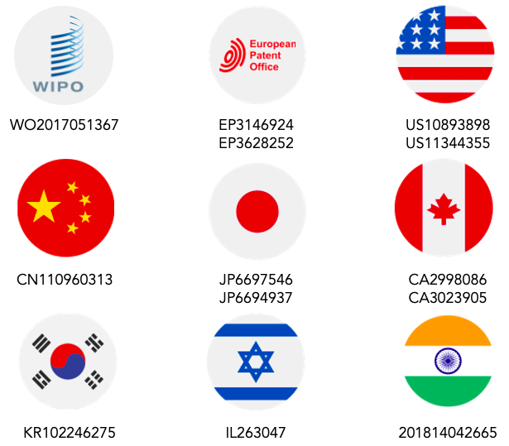
COOLCRYO®
Project progress
2Q
2024
3Q
2024
4Q
2024
2Q
2025
510K
FDA
Beginning of
510K FDA
certification
process
Completion
of EMC in Italy
(Electromagnetic Compatibility)
Completion
of Human Factors
evaluation in USA
Complete
510K FDA
submission
2Q
2023
2Q
2024
2Q
2025
Start of consoles and applicators production
required for V&V studies
and clinical trials
Beginning of
human clinical trial
End of recruitment for clinical trial
Notes:
Q2 2023
Rozpoczęto produkcję; Konsole – 6 sztuk, Aplikatory – 400 sztuk na potrzeby badań weryfikacyjno walidacyjnych i badań klinicznych.
Q3 2024
Uzyskano pozytywny wynik badań biokompatybilności.
Uzyskano pozytywny wynik wstępnych badań EMC systemu.
Wyłoniono ośrodek badawczy do badań klinicznych, głównego badacza oraz CRO (Contact Research Organization).
Potwierdziliśmy możliwość z FDA by pójść ścieżką rejestracji 510K
Q4 2023
Uzyskanie opinii Komisji Bioetycznej i złożenie dokumentacji do URPL.
1Q 2024
Uzyskanie decyzji URPL dot. przeprowadzenia badań klinicznych na 14 pacjentach,
2Q 2024
Badania kliniczne na 14 pacjentach, jeden ośrodek.
4Q 2024
Planowane zakończenie badań klinicznych.
Spodziewamy się również uzyskać decyzję FDA.

Slide 33
COOLCRYO®
CRYOABLATION MARKET VALUE
202 mln USD
Boston Scientific takes over the Cryterion Medical project
MLN USD
450 mln USD
acquisition of the CryoCath Technologies project by Medtronic
115 mln USD
Acquisition by Kardium Inc. (creators of the Globe® system for the treatment of atrial fibrillation)
2020 2022 2024 2026 2028
CRYOABLATION PROCEDURES
MITRAL VALVE REPAIRS
Thousands
Thousands
2020 2022 2024 2026 2028
2020 2022 2024 2026 2028
© 2025 Medinice s.a. All rights reserved.

Slide 34
RF ABLATION
MiniMax®

Slide 35



MINIMAX®
Significant advantages over competitive solutions
Name of device | Minimax® | INTELLANAV™ | NAVISTAR® DS E | Advisor™
Ablation
Irrigation system
3D mapping
Diagnostic catheter (EPS)
© 2025 Medinice s.a. All rights reserved.

Slide 36
MINIMAX®
RF ABLATION MARKET VALUE
316 mln USD
Acquisition of EPIX Therapeutics (Radio Frequency Ablation System) by Medtronic
BLN USD
335 mln USD
Acquisition of ENDOSENSE by St. Jude Medical INC. The company developed medical devices for cardiac ablation .
2020 2022 2024 2026 2028
NUMBER OF RF ABLATIONS
300 mln USD
Acquisition of APAMA by Boston Scientific. Radiofrequency (RF) balloon catheter system for the treatment of atrial fibrillation (AF).
MLN
500 mln USD
Acquisition of Farapulse (pioneer of a new era of cardiac ablation) by Boston Scientific
2020 2022 2024 2026 2028
© 2025 Medinice s.a. All rights reserved.

Slide 37
LAAE
AtriClamp

Slide 38
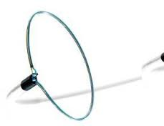
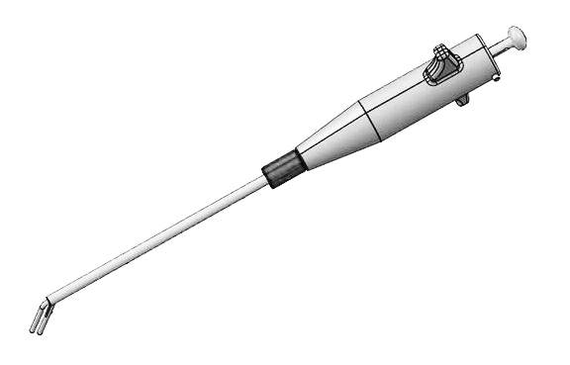
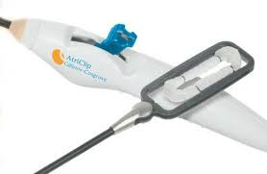
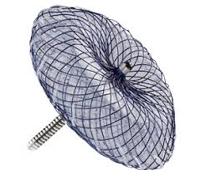
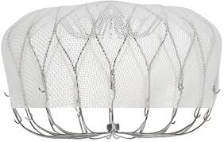
ATRICLAMP
EPICARDIAL
ENDOCARDIAL
HYBRID
Can be recovered, repositioned and redeployed
Durable electrical insulation and no blood permeability
Price
$
$$
$$$$
$$$$
$$$
No threading required
© 2025 Medinice s.a. All rights reserved.

Slide 39
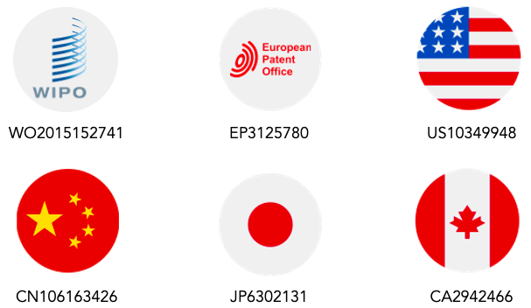
ATRICLAMP
Project progress
3Q
2024
4Q
2025
Start of obtaining FDA 510 K
process
FDA 510K Submission
2Q
2023
2Q
2025
3Q
2025
Design freeze
Pilot production
for Animal Trials
Animal Trials
in GLP standard
© 2025 Medinice s.a. All rights reserved.

Slide 40
ATRICLAMP
MARKET VALUE OF LAAO/LAAC
300 mln USD
Acquisition in 2019 SentreHEART by AtriCure ($40M One-Time Payment + Milestones)
MLN USD
375 mln USD
Acquisition in 2011 Atritech by Boston Scientific ($100 million one-time payment + milestones)
2020 2022 2024 2026 2028
NUMBER OF LAAO TREATMENTS
THOUSANDS
400 mln USD
Acquisition of Laminar
by Johnson & Johnson in 2023
2020 2022 2024 2026 2028
© 2025 Medinice s.a. All rights reserved.
https://www.gminsights.com/industry-analysis/left-atrial-appendage-closure-devices-market

Slide 41
Thank you for your attention
www.medinice.eu

